Slide 1
HK.SHOP.COM
PartnerStore

Slide 2
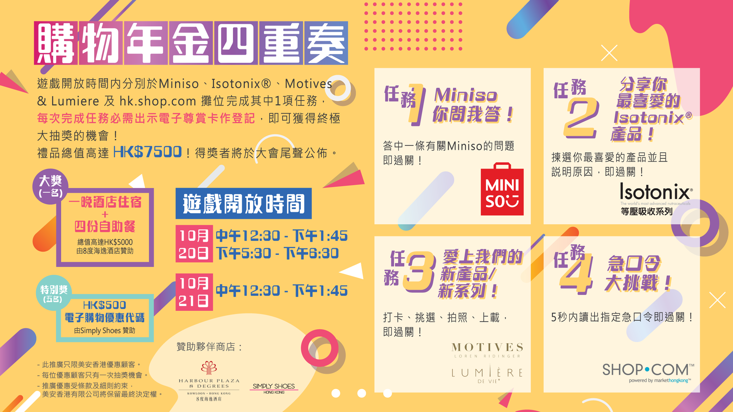

Slide 3
No. of Partner Store
Increased 23%
Jan-Jul 2017 vs Jan-Jul 2018

Slide 4
No. of Partner Store Product Feeds
Increased 10,000 pcs
From AC2018 until now

Slide 5
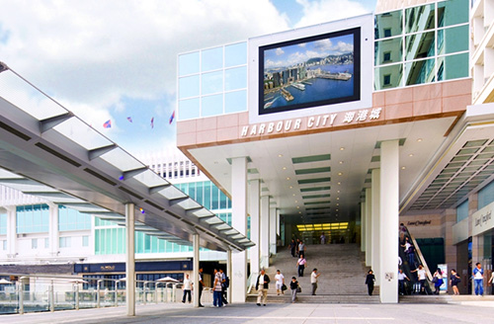
450 stores
3000 stores

Slide 6
Every UnFranchise™ Owner
owns 6 Harbour City malls

Slide 8
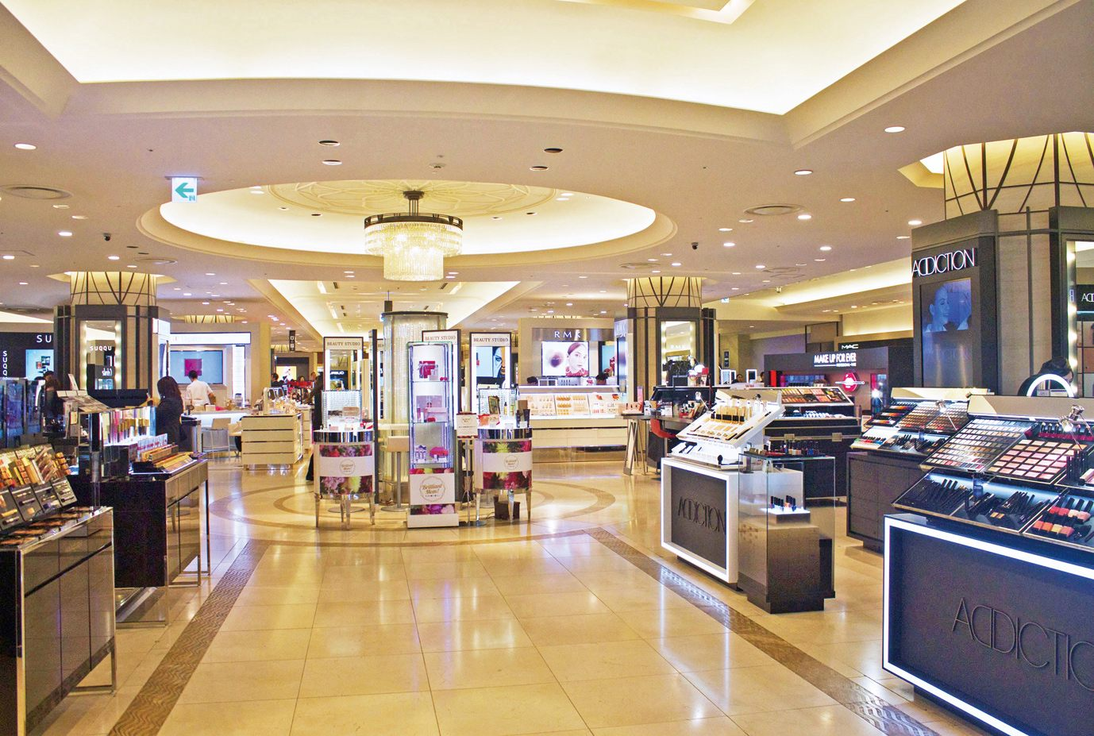
G/F MHK Brands
↓
G/F
G/F
↓
11
11
9
10
9
10
7
8
7
8
5
6
5
6
3
4
3
4
1
2
B1
G
1
2
G
B1

Slide 9
G/F MHK Brands

Slide 10
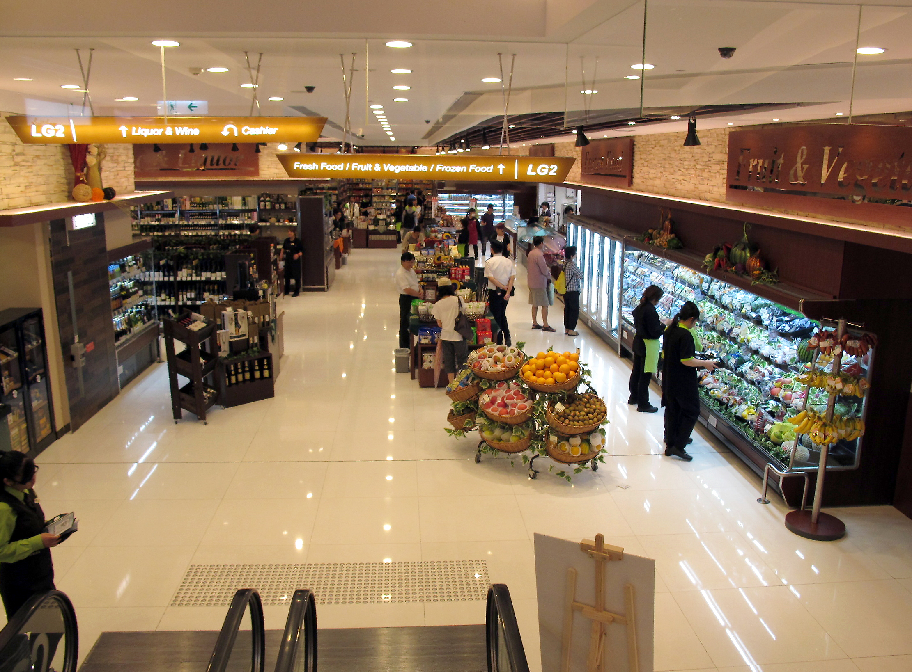
G/F↑
B1 Supermarket and Groceries Stores
↓
G/F↓
B1
G/F↓
G/F ↓
B1
11
11
9
10
9
10
7
8
7
8
5
6
5
6
3
4
1
2
3
4
B1
G
1
2
G
B1

Slide 11
B1 Supermarket and Groceries Stores

Slide 12
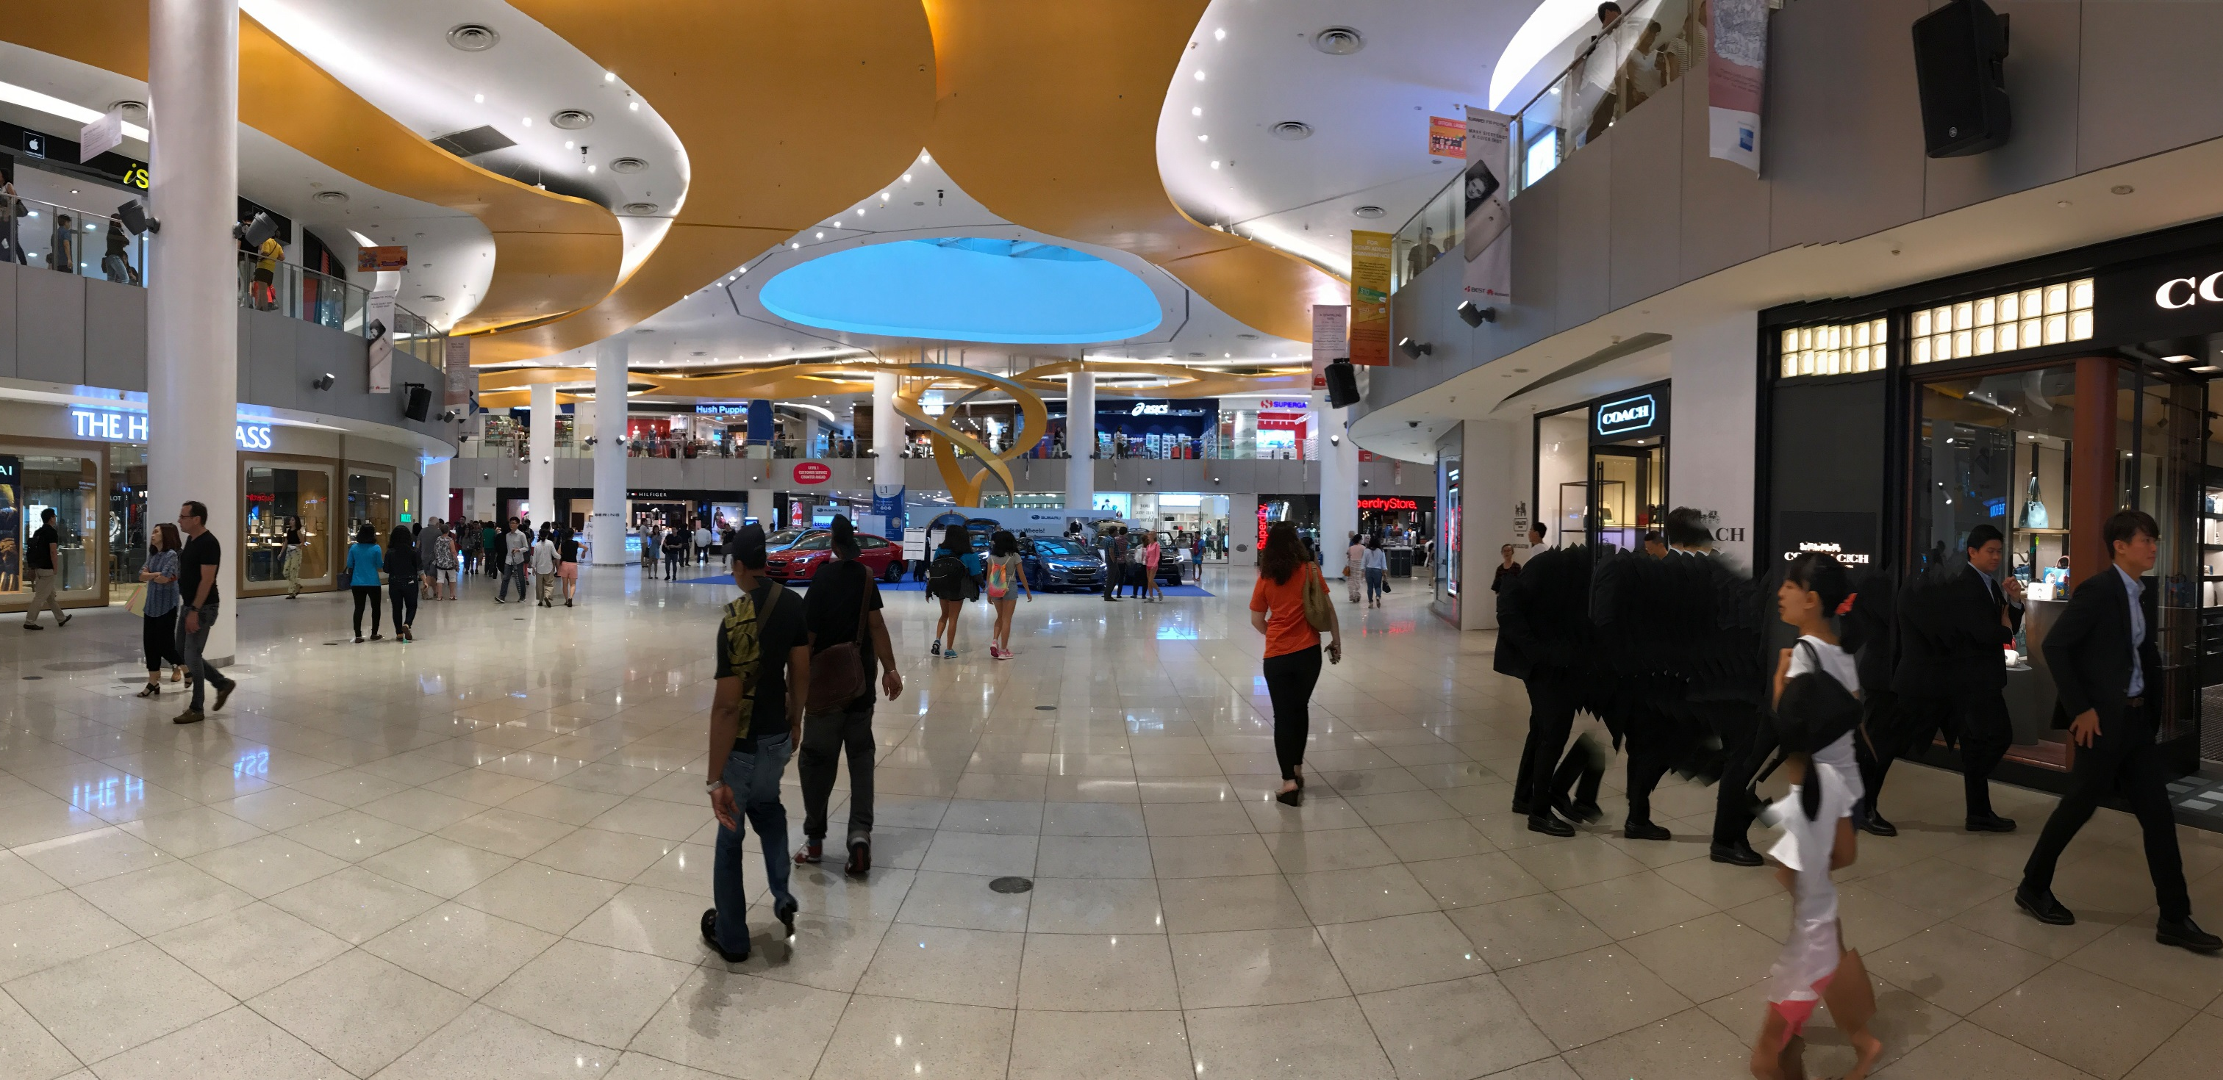
G/F↑
↑
G/F↓
1/F Banking Services
1/F
B/1 ↑
11
9
10
7
8
5
6
3
4
1
2
B1
G

Slide 13
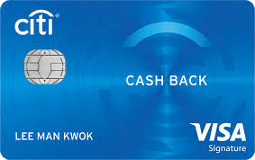
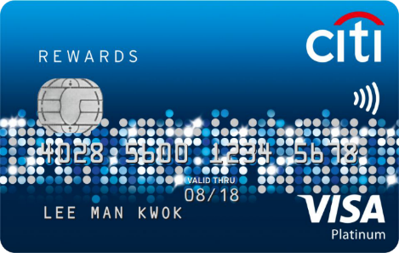
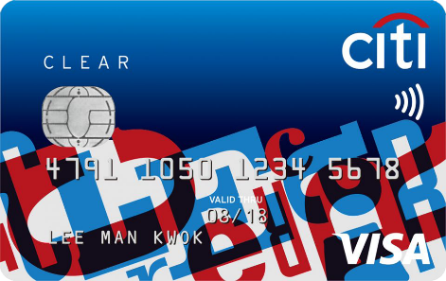
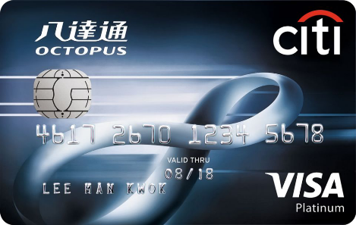
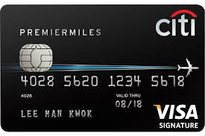
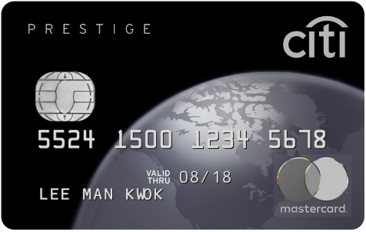
1/F Banking Services
Credit Card Application
Loan Application

Slide 14
Online Store
Banking Services
Citi Priority® is not just a name. It's a suite of services and product offerings tailored to bring you closer to your wealth goals.
To make your investment worthwhile, from personalized rates and services
to long-term investments and financial planning, to free global bank transfers and withdrawals - we've made your banking our priority.
Complete Online Application Successfully and
Register the Citi Priority Banking Account
35 IBV

Slide 15
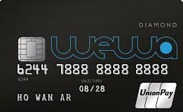
Online Store
Here at PrimeCredit, aside from the low interest offer to all, you can also enjoy the following benefits: – Fast and caring service – Wide branch network – Convenient payment
Apply Online and
Register the Credit Card
25 IBV

Slide 16
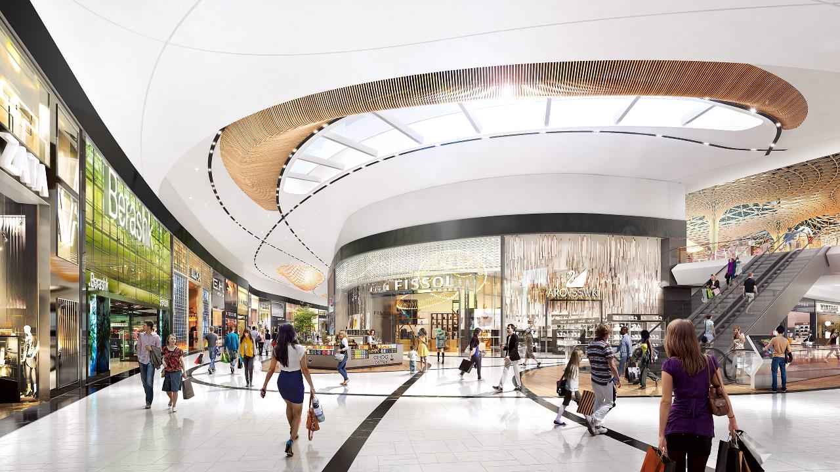
G/F↑
2/F Fashion and Jewelry
G/F↓
↑
2/F
1/F↑
1/F ↑
2/F
11
11
9
10
9
10
7
8
7
8
5
6
5
6
3
4
1
2
3
4
B1
G
1
2
G
B1

Slide 17
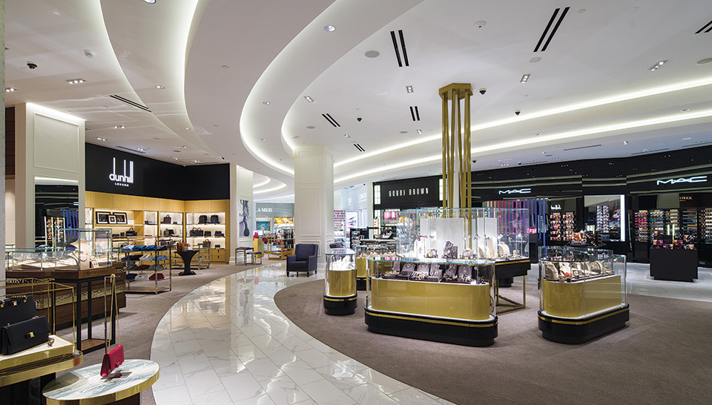
2/F Fashion and Jewelry

Slide 18
Online Store
From what started as a small group of passionate fashion loving individuals in North Brunswick, New Jersey, to a multinational team, SHEIN has grown immensely to what it is today.
The SHEIN girl is fashion forward yet classy, effortlessly cool and unafraid to venture into different styles.

Slide 19
Online Store
Kent & Curwen was established in 1926 by Eric Kent and Dorothy Curwen. The company first began as a manufacturer of military, club, and college repp ties that helped define 20th century British style.
In the 1930s, Kent & Curwen introduced the iconic cricket sweater and went on to be the supplier to major sporting events and clubs even finding its way across the Atlantic to outfit the Hollywood Cricket Club and Palm Springs Racquet Club. It wasn’t long before such royals as the Prince of Wales and the Duke of Kent were seen sporting Kent & Curwen.

Slide 20
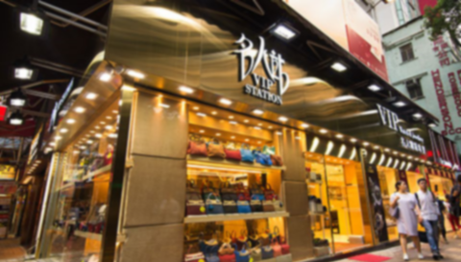
Online Store
Since the opening of the celebrity station in 2000, all goods have been imported directly from Europe and Japan. All of the franchised stores have the "good" guarantee issued by the Hong Kong government and customs.
We are committed to provide priority subscription rights for all major brands of limited products to our valued customers, shortening the waiting time for customers, directly with Europe. The product was released during the same period. Enjoy VIP honor in the first place.
Now selling the following luxury brand goods :
HERMES, CHANEL, LV, GUCCI, PRADA, FENDI, BALENCIAGA, DSQUARED, DIOR, MIU MIU, CHLOE, BOTTEGA VENETA, DOLCE & GABBANA, PATEK PHILIPPE, ROLEX, CARTIER, OMEGA, PANERAI…. and etc.

Slide 21
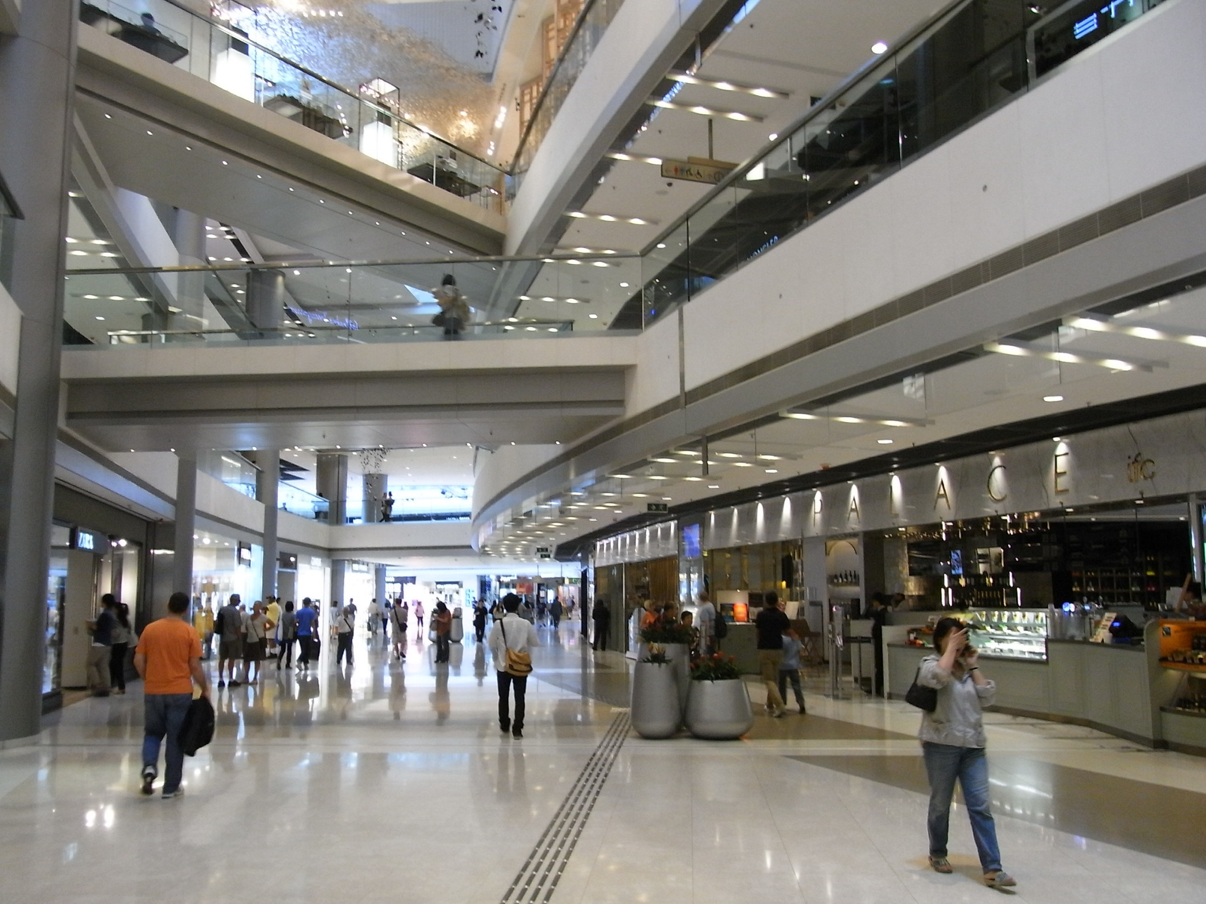
G/F↑
↑
G/F↓
3/F Home Decor
2/F↑
3/F
2/F ↑
3/F
11
11
9
10
9
10
7
8
7
8
5
6
3
4
5
6
1
2
3
4
B1
G
1
2
G
B1

Slide 22
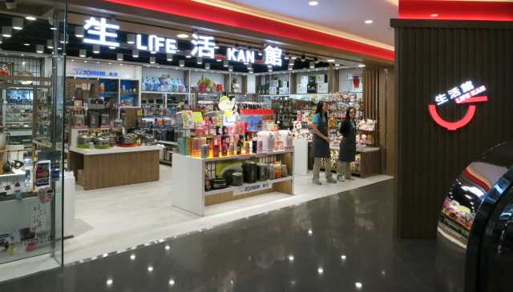
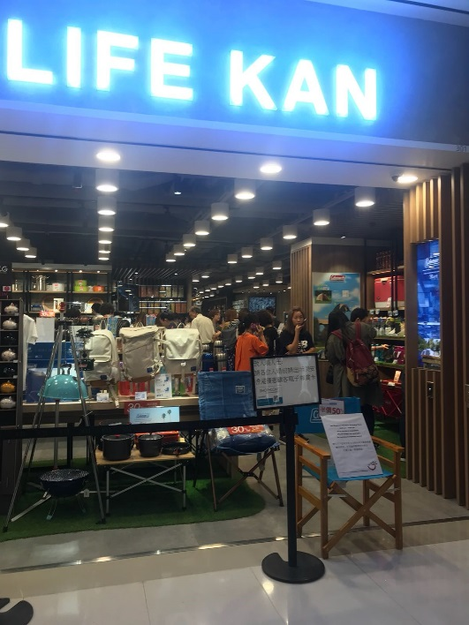
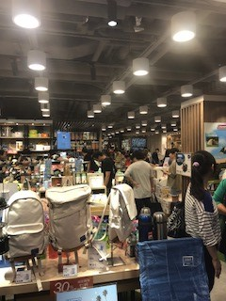
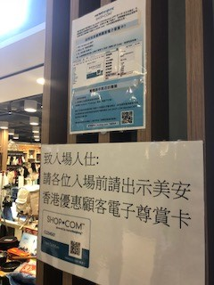
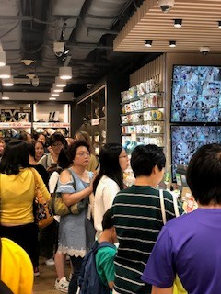
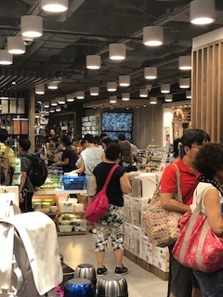
“Market Hong Kong VIP Shopping Day”
Unprecedentedly reserving the whole shop for MHK members
Over 100 orders and $300,000 sales revenue
in 4 hours

Slide 23
3/F Home Decor

Slide 24
Online Store
Nice! It has over 10,000 products
FingerShopping is a famous online store which not only includes well-known brands, but also designer brands, social enterprises and specialty stores; some merchants only operate exclusive online stores or sell exclusive products at FingerShopping, which must be genuine goods!
Shopping at Fingershopping, even if the products come from different online stores, we will collect one delivery for you. In addition to home delivery services (Hong Kong and some Mainland China regions), more than 300 OK convenience stores in the territory will be available for pick-up at the store for over $200, and will pick up the goods at any time in the selected day.

Slide 25
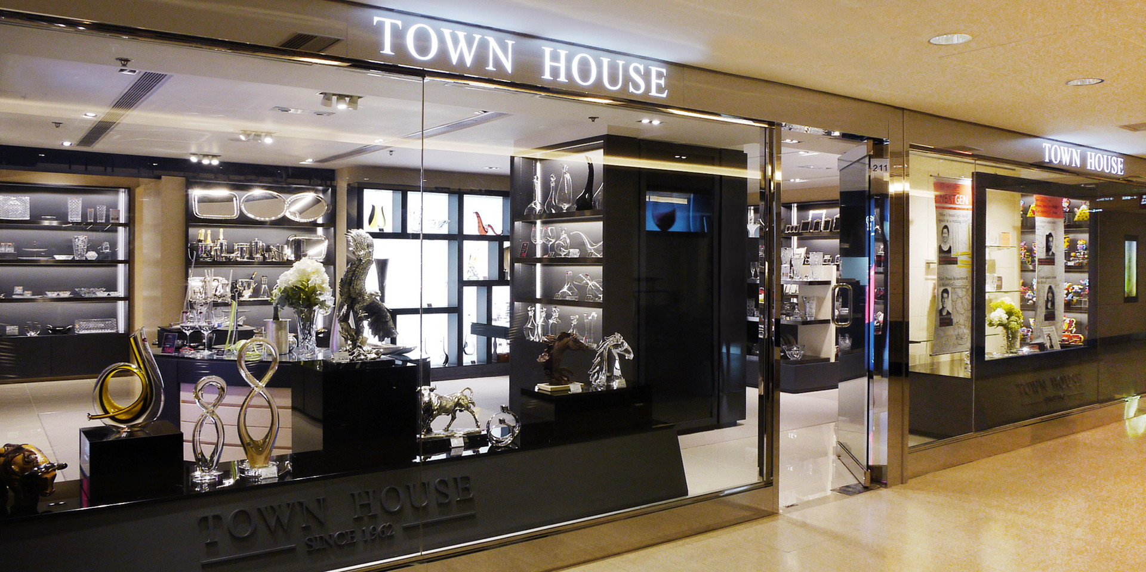
實體商店
早於50年前已在香港開設第一間家品專門店，多年來一直積極引入全球知名的家品及餐具品牌。
現時旗下代理的品牌包括Riedel Crystal、Nachtmann Crystal、Maxwell & Williams、Zanetto Argenti及Carrs Silver等。
分店：
尖沙咀K11, 3 樓, 304 號舖
中環遮太子大廈2 樓210 – 211 號舖
上環德輔道中211 號永安百貨
銅鑼灣崇光百貨10 樓家品部10A 店
油麻地永安九龍中心永安百貨5樓

Slide 27
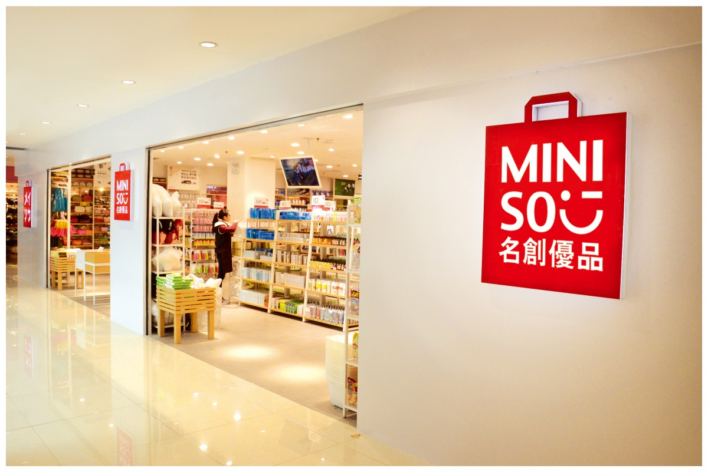
Order Form
2% Cashback
2% IBV│6% IBV
MINISO, a Japanese style home products brand, sticking to the life philosophy of “simplicity, nature and good quality” and the brand proposition of “returning to the nature”. MINISO aims at providing creative products with excellent quality and reasonable price to customers, building a trendy and down-to-earth brand, and making a happy and comfortable home life for every family.
MINISO Cash coupons can be used in more than 40 branches across Hong Kong!!

Slide 28
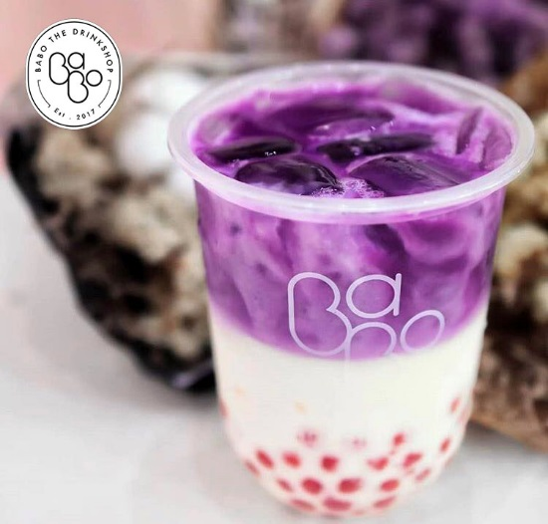
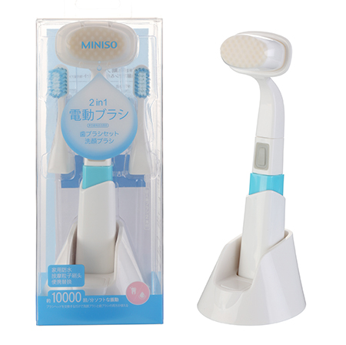
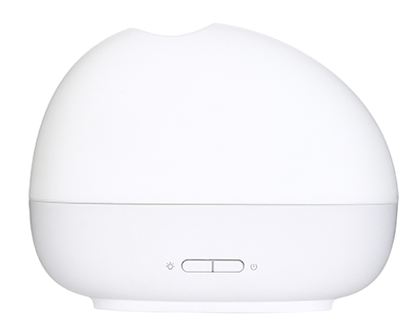
Special Offer
Order Form
2% Cashback
2% IBV│6% IBV
Free Gifts when you purchase MINISO cash coupon with specific value at the MINISO booth during HKLS2018!
Buy more and get more!
worth $200 (280 pcs) Free Bubble Milk Tea Voucher (Value HK$35)
worth $500 (20 pcs) Free Multifunctional facial washing machine (Value HK$49.9)
worth $1200 (10 pcs) Free Aromatherapy machine (Value $119.9)
MINISO Cash coupons can be used in more than 40 branches across Hong Kong!!
Promotion offer and gift are subject to a first-come-first-served basis while stocks last.

Slide 29
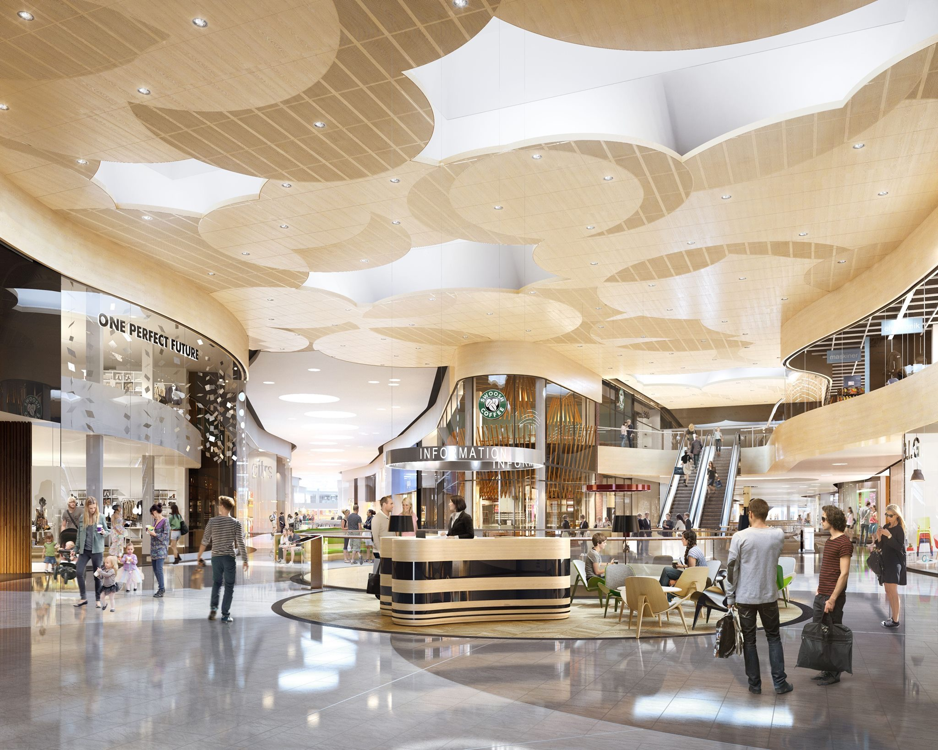
G/F↑
4/F Insurance Service
G/F↓
↑
4/F
3/F↑
11
9
10
7
8
5
6
3
4
1
2
B1
G

Slide 30
4/F Insurance Service

Slide 31
4/F Insurance Service
Do you want ALL the insurance products above?

Slide 32
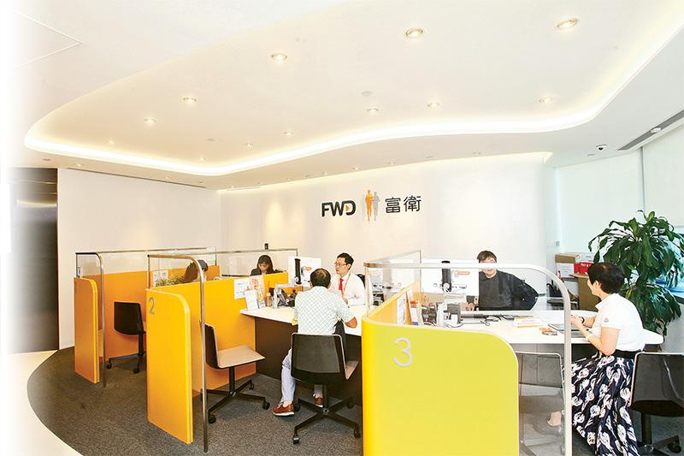
Online Store
FWD’s business spans Hong Kong, Macau, Thailand and the Philippines, offering life insurance services, as well as general insurance, employee benefits and financial planning services in Hong Kong.
FWD also has a brand presence in Indonesia. FWD’s strategic focus is to leverage technology to enhance customer experience, deliver innovative products, and invest in talent to create a leading pan-Asian life insurer that changes the way people feel about insurance.

Slide 33
FWD BoardingCare Plan
We automatically trigger your compensation when your scheduled flight was cancelled or delayed by 3 hours or more.
2 IBV
FWD Travel Insurance
Go crazy and jump for joy! We cover your activities from summer walks along the beach to bungee jumping, scuba diving and even winter sports.
10 IBV
FWD Flight Insurance
We're offering to boost your loved ones' support in the event of accidental death
1 IBV
*Get a fixed IBV for every successfully purchase an insurance plan
*Information is provided by FWD General Insurance Company Limited.
*FWD BoardingCare Plan, FWD Travel Insurance and FWD Flight Insurance are underwritten by FWD General Insurance Company Limited.
*Please refer to the FWD website and policy provisions for product details.

Slide 34
FWD Home Liability
Home Liability provides worldwide cover for your legal liability against any claim for bodily injury or property damage resulting from the negligence of you or your family members normally living with you
4 IBV
FWD Home Insurance
You'll receive extensive 'All Risks' cover, from your furniture to your freezer food, you are protected.
8 IBV
*Get a fixed IBV for every successfully purchase an insurance plan
*Information is provided by FWD General Insurance Company Limited.
*FWD Home Liability and FWD Home Insurance are underwritten by FWD General Insurance Company Limited.
*Please refer to the FWD website and policy provisions for product details.

Slide 35
FWD MotorSmart Insurance
Enjoy pure driving pleasure knowing your precious ride is covered by FWD MotorSmart Insurance, offer an array of coverage to protect you against loss of or damage to your car, medical expenses, your liability to third parties and property damage.
15 IBV
*Get a fixed IBV for every successfully purchase an insurance plan
*Information is provided by FWD General Insurance Company Limited.
*FWD MotorSmart Insurance is underwritten by FWD General Insurance Company Limited.
*Please refer to the FWD website and policy provisions for product details.

Slide 36
為您和家人提供財務保障，保費於首20個保單年度更保證維持不變，最可選擇按年、每半年或每月繳費
FWD Provie Insurance Plan
Provie Insurance Plan offers a Guaranteed Crediting Interest Rate in the first 5 policy years, allowing your savings to grow. It also provides life protection and a complimentary rider, so get set and go for your goals now!
25 IBV
FWD Elite Term Plan
FWD Elite Term Plan offers financial security for you and your loved ones. It is guaranteed to remain unchanged for the first 20 policy years, and it can be paid monthly, semi-annually or annually.
130 IBV
FWD Savie Insurance Plan
FWD Savie Insurance Plan provides you with the guaranteed annual crediting interest rate while also enjoying the freedom to make flexible withdrawals at no charge.
25 IBV (Make an Appointment)
85 IBV (Purchase Online)
*Get a fixed IBV for every successfully purchase an insurance plan
*Information is provided by FWD General Insurance Company Limited.
*FWD Provie Insurance Plan, FWD Elite Term Plan and FWD Savie Insurance Plan are underwritten by FWD General Insurance Company Limited.
*Please refer to the FWD website and policy provisions for product details.

Slide 37
FWD CANsurance Cancer Protection Plan
An all-round cancer protection plan which allows you to convert to a designated medical reimbursement plan upon retirement, catering to your medical needs and empowering you to face challenges at all stages of your life.
20 IBV
FWD EasyHealth Refundable Hospital Income Plan
EasyHealth Refundable Hospital Income Plan provides you Daily Hospital Cash Benefit, regardless of the actual hospital expenses. Even if you surrender the policy before the maturity, starting from the 6th policy year you can get back a percentage of actual premium paid.
150 IBV
*Get a fixed IBV for every successfully purchase an insurance plan
*Information is provided by FWD General Insurance Company Limited.
*FWD CANsurance Cancer Protection Plan and FWD EasyHealth Refundable Hospital Income Plan are underwritten by FWD General Insurance Company Limited.
*Please refer to the FWD website and policy provisions for product details.

Slide 38
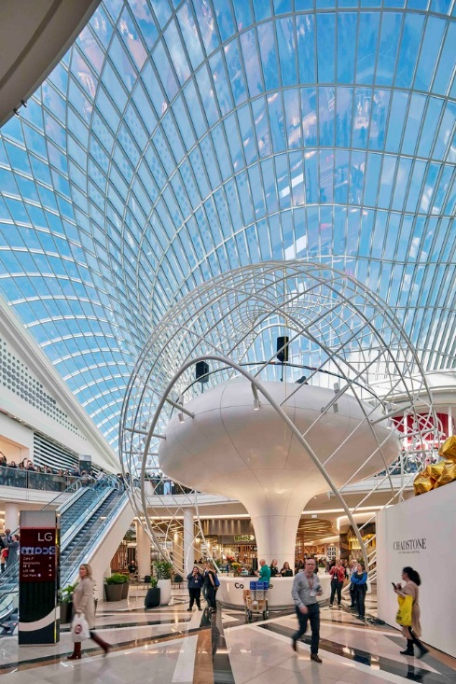
G/F↑
5/F Leisure
G/F↓
↑
5/F
4/F↑
11
9
10
7
8
5
6
3
4
1
2
B1
G

Slide 39
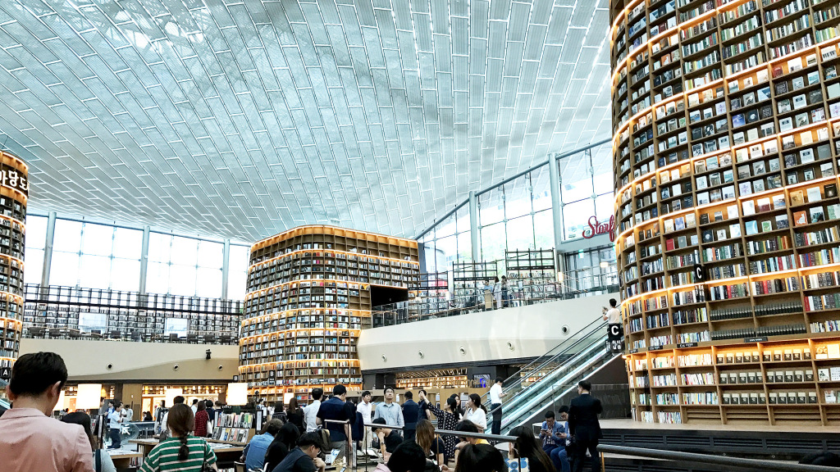
5/F Leisure

Slide 40
Online Store
MOOV is the HK’s largest multi-platform digital music service that belongs to local music lovers providing premium and the best user experience.
Enjoy the latest releases as well as classics of Cantonpop, international tunes and the largest K-pop library within territory.

Slide 41
G/F↑
6/F Restaurant
G/F↓
↑
5/F↑
6/F
11
9
10
7
8
5
6
3
4
1
2
B1
G

Slide 42
6/F Restaurant

Slide 43
Order Form
5% Cashback
3% IBV│11% IBV
Hung Fook Tong is the top retailer of Chinese herbal products in Hong Kong. It has transformed from a traditional Chinese herbal tea shop to a modern wellness concept food and beverage enterprise, which has diversified its products to cover Chinese herbal drinks and other non-herbal drinks, Chinese-style soups, tortoise herbal jelly and other food products.
MARKET HONG KONG x Hung Fook Tong - Special Privilege
- Hung Fook Tong $50 Gift Voucher (11pcs/set)
- Hung Fook Tong Herbal tea Package (10pcs/set)
- Hung Fook Tong Soup Package (10pcs/set)

Slide 44
Order Form
5% Cashback
3% IBV│11% IBV
Hung Fook Tong
Order Form

Slide 45
G/F↑
7/F Travel
G/F↓
↑
7/F
6/F↑
11
9
10
7
8
5
6
3
4
1
2
B1
G

Slide 46
7/F Travel

Slide 47
Online Store
Internet Roaming
Airport Transportation
Attractions
Car Rental
KKday is Asia's largest travel experience platform, dedicated to making it easier and safer for travelers to experience local itineraries. We are convinced to provide the most accessible way to travel, and we are constantly looking for unique experience and activities around the world. Invite you as much as we love to travel, discover trips on KKday, book easily, and create your unique travel memories.
Sabah
Tokyo
Taipei
Melbourne
Vancouver
Singapore
Paris
Seoul
Sydney
Vietnam
Bangkok

Slide 48
Walk-in Store
Founded in 1928, Hong Kong China Travel Service is the first travel agency in Hong Kong to be run by the Chinese. It is one of the largest travel agencies in Hong Kong.
Main business includes: organizing travel teams to mainland China and around the world, providing various hospitality services for tourists and business people from mainland China and the rest of the world to Hong Kong and Macao, and signing various travel documents to handle all kinds of travel documents around the world. Sea, land and air ticketing, hotel reservation, Hong Kong port reception service, sales of Guangdong, Hong Kong and Macao multiple attractions tickets, free travel packages.
*Apply for specified branches ONLY

Slide 50
More Surprises
More Prizes
!!

Slide 51
Booking period : 20 Oct – 30 Nov 2018
Consumption period : Completed the room stays On/before 31 Jan 2019
Anyone can participate in the event if the purchase is worth HK$2,400

Slide 52
G/F↑
8/F Telecommunications
G/F↓
↑
8/F
7/F↑
11
9
10
7
8
5
6
3
4
1
2
B1
G

Slide 53
8/F Telecommunications service
Mobile Plan
Fiber Broadband

Slide 54
Online Store
Birdie is on a quest to set you free from conventional mobile telecom operators. Birdie don’t offer complicated tariff plans to lock you in for years.
Birdie also don’t operate stores because our mobile app has all the essential service features you’ll ever need right at your fingertips.
1 IBV (Mobile Plan $48)
4 IBV (Mobile Plan $90)
6 IBV (Mobile Plan $120 / $140)

Slide 55
9/F Lifestyle
↑
9/F
8/F↑
11
9
10
7
8
5
6
3
4
1
2
B1
G

Slide 56
cac
9/F Lifestyle

Slide 57
Online Store
Discover the hidden beauty from ordinary life, and design furniture with simple expression, but full of wonder and delight.
We hope to make quality design furniture accessible and affordable and to think with heart, feel with brain.

Slide 58
Online Store
HKDECOMAN.com was launched in November 2015 and committed to make no defected/unfinished decoration.
According to the statistics produced by a third-party platform, the traffic of HKDECOMAN.com is first decoration platform in Hong Kong.

Slide 59
Online Store
EnglishTown is the largest professional English education organization in the world. Its group operates over 400 schools and offices in 75 countries, hire over 27,000 foreign teachers and provide the best quality English education to over 15 million learners.
Sign up Daily English and
Receive the verification from EnglishTown
3 IBV

Slide 60
10/F Fitness
↑
9/F↑
10/F
11
9
10
7
8
5
6
3
4
1
2
B1
G

Slide 61
10/F Fitness

Slide 62
Online Store
GUAVAPASS :The Best In Premium Fitness Classes
GUAVAPASS curated an elite list of fitness classes in Hong Kong and Asia. Empowering you with an unlimited variety of classes from Yoga to Kickboxing, Spinning to Dance, CrossFit to Pilates. A new way to sweat everyday!
Boxing
Spinning
Dance
Barre
Pilates
Boot camp
Yoga

Slide 63
11/F Electronic
↑
11/F
10/F↑
11
9
10
7
8
5
6
3
4
1
2
B1
G

Slide 64
11/F Electronic products

Slide 66
Online Store
Chung Yuen Electrical was founded in year 1927, and had officially registered as Chung Yuen Electrical Company Limited since 1960. Its main business is distribution of electrical appliances and is one of the top electrical retailers in Hong Kong.
Serving local market for over 90 years, they do have retail branches spreading across different districts in Hong Kong, providing varieties to consumers such as audio-visual products, digital and mobile products, home appliances, beauty & personal care items, etc. They provide professional and quality services, under the mission of “Always Taking Consumers as the Priority”, scoping with your daily needs.

Slide 67
Online Store
Founded in 1927
One of the largest retail chain of electrical appliances in HK
Sole agent of Daikin household-type split air conditioners
Wholesaler of other electronic products
Currently 8 Chung Yuen stores

Slide 68
Online Store
TV, Digital Camera, Digital SLR Camera, Smartphone, Home Appliances etc.

Slide 69
Online Store
8 Retail Stores in Hong Kong
Over 50 popular Electronic Brands

Slide 70
Market Hong Kong
VIP Shopping Day
Vuene: Mong Kok MOKO
Date : In late Nov 2018

Slide 72
最新加盟星級夥伴商店
11個全方位保險服務
City Priority 戶口申請

